Slide 1

Python! Day 7
Rock paper scissors video game
For each loops and looping through lists
Modulo operator

Slide 2
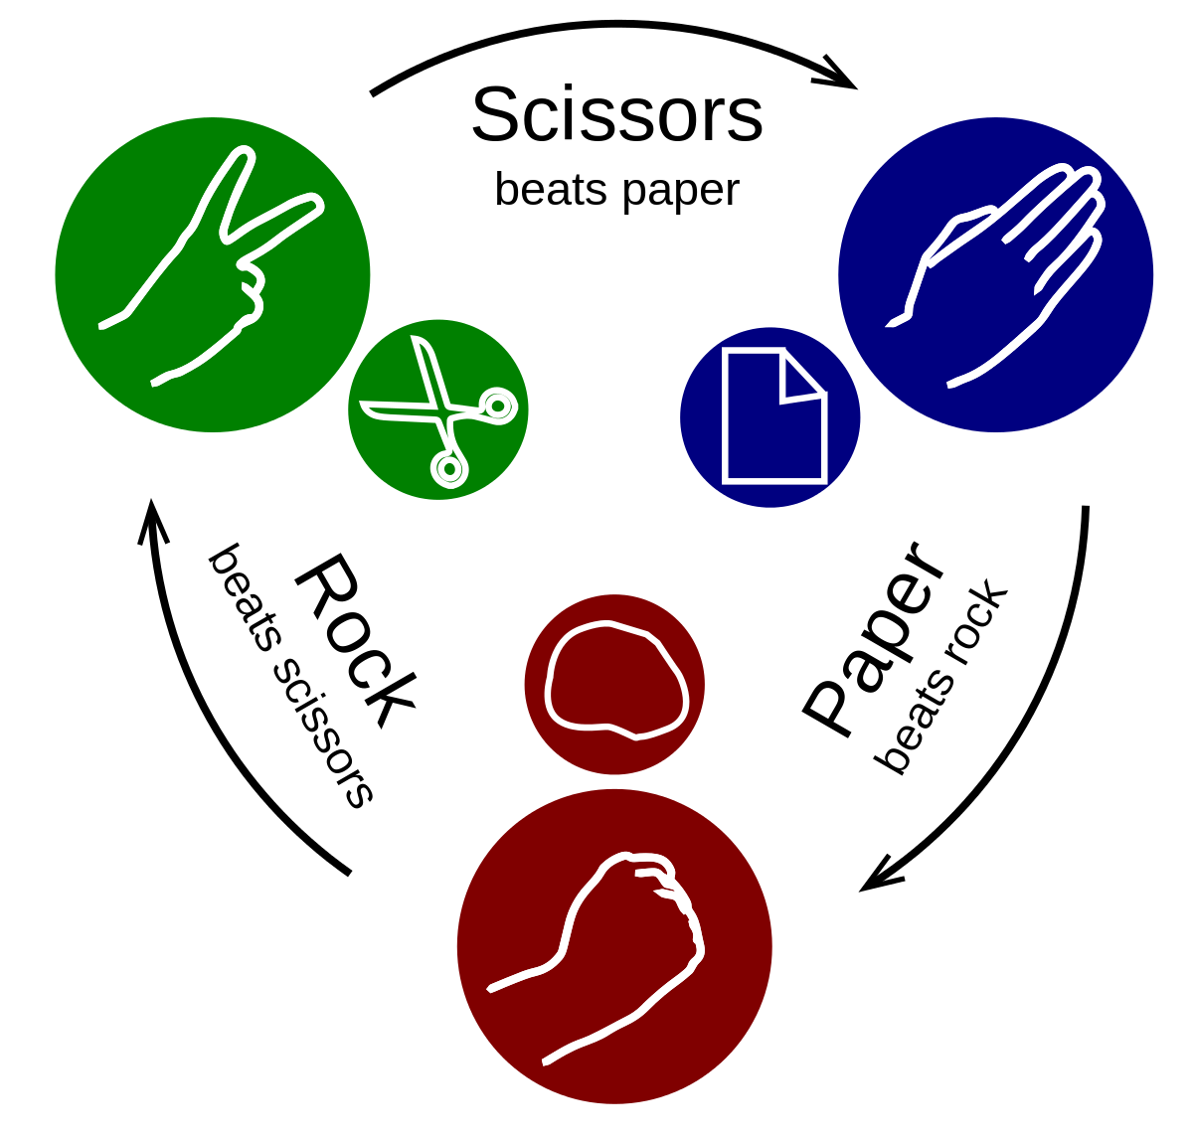
Warm-Up Project: Rock Paper Scissors
We can make a more fun version of our coin flip program by turning it into a rock-paper-scissors game where the user competes against the computer
The user would enter “rock” “paper” or “scissors” and the program would also choose “rock” “paper” or “scissors” based on a random number
Hint: use random.randint(1, 3) and if, elif, and else statements

Slide 3

For Each Loops – Looping Through Lists
What if we have a list of numbers like: [1, 2, 6, 8, 3, 0] and we want to print what every number is multiplied by three
For this we can use a for-each loop
For-each loops look like this:
for item in list_of_items:
do this
To print every item in the number list multiplied by 3, we’d write:
for number in number_list:
print(number * 3)

Slide 4

Restrictions of For-Each Loops
Notice that if we do this:
num_list = [1, 2, 3, 4, 5]
for num in num_list:
num *= 3
print(num_list)
The num list doesn’t change after the for-each loop
If we want to change every item of a list, we must use a for-loop like this
num_list = [1, 2, 3, 4, 5]
for n in range(0, len(num_list)):
num_list[n] *= 3
print(num_list)

Slide 5

Project: Password Generator
Let’s create a program that asks the user how many letters, symbols, and numbers they want in their password and then randomly generates a password
For this, we can create some lists of all possible letters, numbers, and symbols so we can generate a random index of the list
These lists might look like this:
letters = [“a”, “b”, “c”, “d”, “e”, “f”, “g”, “h”, “i”, “j”, “k”, “l”, “m”, “n”, “o”, “p”, “q”, “r”, “s”, “t”, “u”, “v”, “w”, “x”, “y”, “z”]
numbers = [“0”, “1”, “2”, “3”, “4”, “5”, “6”, “7”, “8”, “9”]
symbols = [“!”, “@”, “#”, “$”, “^”, “&”, “*”, “(“, “)”]
This Photo by Unknown Author is licensed under CC BY-SA

Slide 6
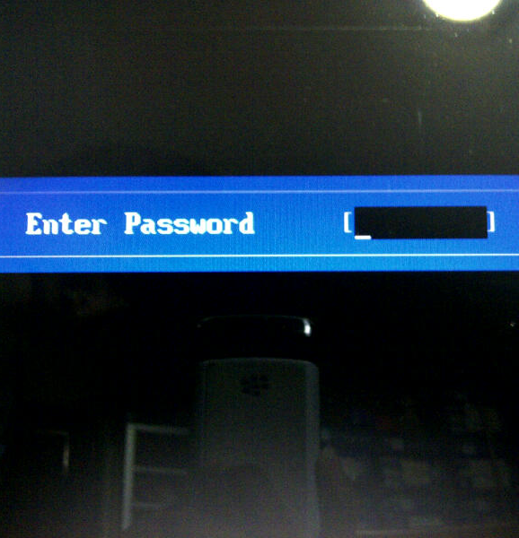
components = []
for n in range(0, num_letters):
index = random.randint(0, len(letters) – 1)
components.append(letters[index])
for n in range(0, num_numbers):
index = random.randint(0, len(numbers) – 1)
components.append(numbers[index])
for n in range(0, num_symbols):
index = random.randint(0, len(symbols) – 1)
components.append(symbols[index])
password = “”
for n in components:
password += n
print(“Your password is : “ + password”)
This Photo by Unknown Author is licensed under CC BY-SA

Slide 7
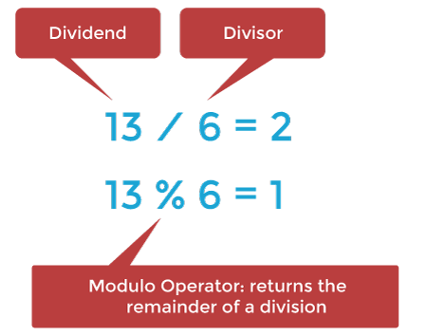
Modulo Operator
Back when we learned about adding, subtraction, multiplying, and dividing in Python, there was another operator besides these ones that looks like this: %
% is the modulo operator, and it gives us the remainder of a division equation
For example, the remainder of 5 / 3 is 2, so 5 % 3 = 2
There is no remainder for 15 / 5, so 15 % 5 = 0
Try it out like this:
print(5 % 4)
print(3 % 4)
print(5 % 5)

Slide 8
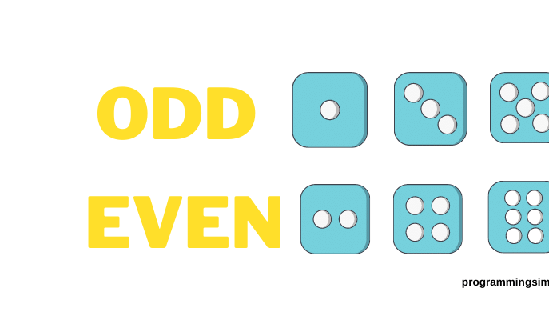
Modulo Operator: Uses
The Modulo operator is mainly useful when checking to see if one number is dividable by another number
For example: 10 is divisible by 5 because 10 % 5 = 0
But 7 is not dividable by 5 because 7 % 5 = 2, not 0
This is particularly useful when checking to see if a number is even
If the number % 2 = 0, then the number is even, if the number % 2 = 1, then its odd
For example:
1 % 2 = 1, so 1 is odd
2 % 2 = 0, so 2 is even
14,536,225,634 % 2 = 0, so 14,536,225,634 is even
This Photo by Unknown Author is licensed under CC BY-NC-ND

Slide 9

Project: Even Number Addition
Let’s write a program that adds all the even numbers between 0 and a certain number
We’ll start with adding all the even numbers between 0 and 1000
Hint: We’ll need to use a for loop and the modulo operator

